Slide 1
Introduction to Parallel and Distributed Programming and Hadoop
Péter Molnár
Institute for Insight
J. Mack Robinson College of Business
Georgia State University

Slide 2

Introduction to Parallel Coputing
Traditionally, software has been written for serial computation:
To be run on a single computer having a single Central Processing Unit (CPU);
A problem is broken into a discrete series of instructions.
Instructions are executed one after another.
Only one instruction may execute at any moment in time.

Slide 3

Using multiple processors in parallel
In the simplest sense, parallel computing is the simultaneous use of multiple compute resources to solve a computational problem.
To be run using multiple CPUs
A problem is broken into discrete parts that can be solved concurrently
Each part is further broken down to a series of instructions
Instructions from each part execute simultaneously on different CPUs

Slide 4
Resources
Challenge
The compute resources can include:
A single computer with multiple processors;
A single computer with (multiple) processor(s) and some specialized computer resources (GPU, FPGA …)
An arbitrary number of computers connected by a network;
A combination of both.
The computational problem usually demonstrates characteristics such as the ability to be:
Broken apart into discrete pieces of work that can be solved simultaneously;
Execute multiple program instructions at any moment in time;
Solved in less time with multiple compute resources than with a single compute resource.

Slide 5
Limitations of Serial Computing
Limits to serial computing - both physical and practical reasons pose significant constraints to simply building ever faster serial computers.
Transmission speeds - the speed of a serial computer is directly dependent upon how fast data can move through hardware. Absolute limits are the speed of light (30 cm/nanosecond) and the transmission limit of copper wire (9 cm/nanosecond). Increasing speeds necessitate increasing proximity of processing elements.
Limits to miniaturization - processor technology is allowing an increasing number of transistors to be placed on a chip. However, even with molecular or atomic-level components, a limit will be reached on how small components can be.
Economic limitations - it is increasingly expensive to make a single processor faster. Using a larger number of moderately fast commodity processors to achieve the same (or better) performance is less expensive.

Slide 6
Von Neumann Architecture
For over 40 years, virtually all computers have followed a common machine model known as the von Neumann computer. Named after the Hungarian mathematician John von Neumann.
A von Neumann computer uses the stored-program concept. The CPU executes a stored program that specifies a sequence of read and write operations on the memory.

Slide 7
Flynn's Classical Taxonomy
There are different ways to classify parallel computers. One of the more widely used classifications, in use since 1966, is called Flynn's Taxonomy.
Flynn's taxonomy distinguishes multi-processor computer architectures according to how they can be classified along the two independent dimensions of Instruction and Data. Each of these dimensions can have only one of two possible states: Single or Multiple.

Slide 8
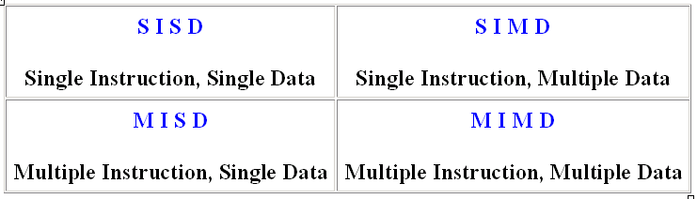
Flynn Matrix
The matrix below defines the 4 possible classifications according to Flynn

Slide 9
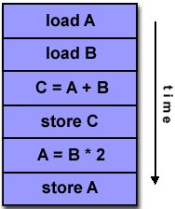
Single Instruction, Single Data (SISD)
A serial (non-parallel) computer
Single instruction: only one instruction stream is being acted on by the CPU during any one clock cycle
Single data: only one data stream is being used as input during any one clock cycle
Deterministic execution
This is the oldest and until recently, the most prevalent form of computer
Examples: most PCs, single CPU workstations and mainframes

Slide 10
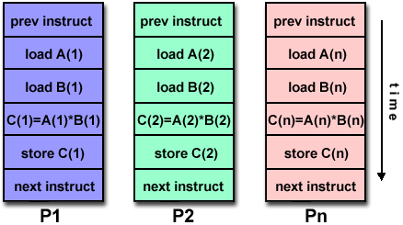
Single Instruction, Multiple Data (SIMD)
A type of parallel computer
Single instruction: All processing units execute the same instruction at any given clock cycle
Multiple data: Each processing unit can operate on a different data element
This type of machine typically has an instruction dispatcher, a very high-bandwidth internal network, and a very large array of very small-capacity instruction units.
Best suited for specialized problems characterized by a high degree of regularity,such as image processing.
Synchronous (lockstep) and deterministic execution
Two varieties: Processor Arrays and Vector Pipelines

Slide 11
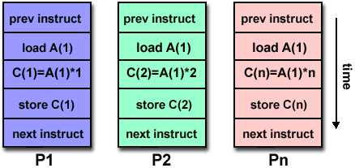
Multiple Instruction, Single Data (MISD)
A single data stream is fed into multiple processing units.
Each processing unit operates on the data independently via independent instruction streams.
Few actual examples of this class of parallel computer have ever existed. One is the experimental Carnegie-Mellon C.mmp computer (1971).
Some conceivable uses might be:
multiple frequency filters operating on a single signal stream
multiple cryptography algorithms attempting to crack a single coded message.

Slide 12
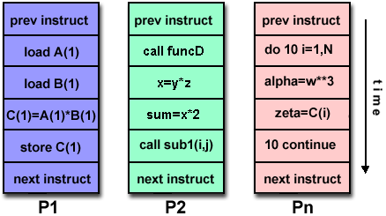
Multiple Instruction, Multiple Data (MIMD)
Currently, the most common type of parallel computer. Most modern computers fall into this category.
Multiple Instruction: every processor may be executing a different instruction stream
Multiple Data: every processor may be working with a different data stream
Execution can be synchronous or asynchronous, deterministic or non-deterministic
Examples: most current supercomputers, networked parallel computer "grids" and multi-processor SMP computers - including some types of PCs.

Slide 13
Task
A logically discrete section of computational work. A task is typically a program or program-like set of instructions that is executed by a processor.
Parallel Task
A task that can be executed by multiple processors safely (yields correct results)
Serial Execution
Execution of a program sequentially, one statement at a time. In the simplest sense, this is what happens on a one processor machine. However, virtually all parallel tasks will have sections of a parallel program that must be executed serially.
Parallel Execution
Execution of a program by more than one task, with each task being able to execute the same or different statement at the same moment in time.
Shared Memory
From a strictly hardware point of view, describes a computer architecture where all processors have direct (usually bus based) access to common physical memory. In a programming sense, it describes a model where parallel tasks all have the same "picture" of memory and can directly address and access the same logical memory locations regardless of where the physical memory actually exists.
Distributed Memory
In hardware, refers to network based memory access for physical memory that is not common. As a programming model, tasks can only logically "see" local machine memory and must use communications to access memory on other machines where other tasks are executing.

Slide 14
Communications
Parallel tasks typically need to exchange data. There are several ways this can be accomplished, such as through a shared memory bus or over a network, however the actual event of data exchange is commonly referred to as communications regardless of the method employed.
Synchronization
The coordination of parallel tasks in real time, very often associated with communications. Often implemented by establishing a synchronization point within an application where a task may not proceed further until another task(s) reaches the same or logically equivalent point.
Synchronization usually involves waiting by at least one task, and can therefore cause a parallel application's wall clock execution time to increase.
Granularity
In parallel computing, granularity is a qualitative measure of the ratio of computation to communication.
Coarse: relatively large amounts of computational work are done between communication events
Fine: relatively small amounts of computational work are done between communication events
Observed Speedup
Observed speedup of a code which has been parallelized, defined as:
wall-clock time of serial execution
wall-clock time of parallel execution
One of the simplest and most widely used indicators for a parallel program's performance.

Slide 15
Parallel Overhead
The amount of time required to coordinate parallel tasks, as opposed to doing useful work. Parallel overhead can include factors such as:
Task start-up time
Synchronizations
Data communications
Software overhead imposed by parallel compilers, libraries, tools, operating system, etc.
Task termination time
Massively Parallel
Refers to the hardware that comprises a given parallel system - having many processors. The meaning of many keeps increasing, but currently BG/L pushes this number to 6 digits.
Scalability
Refers to a parallel system's (hardware and/or software) ability to demonstrate a proportionate increase in parallel speedup with the addition of more processors. Factors that contribute to scalability include:
Hardware - particularly memory-cpu bandwidths and network communications
Application algorithm
Parallel overhead related
Characteristics of your specific application and coding

Slide 16
Parallel Computer Memory Architectures

Slide 17
Memory architectures
Shared Memory
Distributed Memory
Hybrid Distributed-Shared Memory

Slide 18
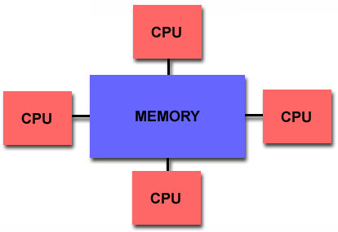
Shared Memory
Shared memory parallel computers vary widely, but generally have in common the ability for all processors to access all memory as global address space.
Multiple processors can operate independently but share the same memory resources.
Changes in a memory location effected by one processor are visible to all other processors.
Shared memory machines can be divided into two main classes based upon memory access times: UMA and NUMA.

Slide 19
Shared Memory : UMA vs. NUMA
Uniform Memory Access (UMA):
Most commonly represented today by Symmetric Multiprocessor (SMP) machines
Identical processors
Equal access and access times to memory
Sometimes called CC-UMA - Cache Coherent UMA. Cache coherent means if one processor updates a location in shared memory, all the other processors know about the update. Cache coherency is accomplished at the hardware level.
Non-Uniform Memory Access (NUMA):
Often made by physically linking two or more SMPs
One SMP can directly access memory of another SMP
Not all processors have equal access time to all memories
Memory access across link is slower
If cache coherency is maintained, then may also be called CC-NUMA - Cache Coherent NUMA

Slide 20
Shared Memory: Pro and Con
Advantages
Global address space provides a user-friendly programming perspective to memory
Data sharing between tasks is both fast and uniform due to the proximity of memory to CPUs
Disadvantages:
Primary disadvantage is the lack of scalability between memory and CPUs. Adding more CPUs can geometrically increases traffic on the shared memory-CPU path, and for cache coherent systems, geometrically increase traffic associated with cache/memory management.
Programmer responsibility for synchronization constructs that insure "correct" access of global memory.
Expense: it becomes increasingly difficult and expensive to design and produce shared memory machines with ever increasing numbers of processors.

Slide 21
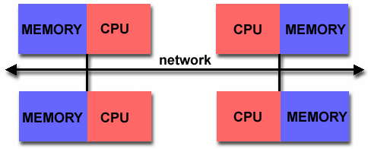
Distributed Memory
Like shared memory systems, distributed memory systems vary widely but share a common characteristic. Distributed memory systems require a communication network to connect inter-processor memory.
Processors have their own local memory. Memory addresses in one processor do not map to another processor, so there is no concept of global address space across all processors.
Because each processor has its own local memory, it operates independently. Changes it makes to its local memory have no effect on the memory of other processors. Hence, the concept of cache coherency does not apply.
When a processor needs access to data in another processor, it is usually the task of the programmer to explicitly define how and when data is communicated. Synchronization between tasks is likewise the programmer's responsibility.
The network "fabric" used for data transfer varies widely, though it can can be as simple as Ethernet.

Slide 22
Distributed Memory: Pro and Con
Advantages
Memory is scalable with number of processors. Increase the number of processors and the size of memory increases proportionately.
Each processor can rapidly access its own memory without interference and without the overhead incurred with trying to maintain cache coherency.
Cost effectiveness: can use commodity, off-the-shelf processors and networking.
Disadvantages
The programmer is responsible for many of the details associated with data communication between processors.
It may be difficult to map existing data structures, based on global memory, to this memory organization.
Non-uniform memory access (NUMA) times

Slide 23
Message Passing Model
The message passing model demonstrates the following characteristics:
A set of tasks that use their own local memory during computation. Multiple tasks can reside on the same physical machine as well across an arbitrary number of machines.
Tasks exchange data through communications by sending and receiving messages.
Data transfer usually requires cooperative operations to be performed by each process. For example, a send operation must have a matching receive operation.

Slide 24
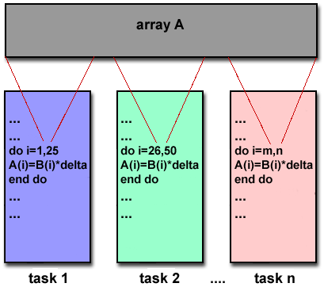
Message Passing Model Implementations: MPI
MPI is now the "de facto" industry standard for message passing, replacing virtually all other message passing implementations used for production work. Most, if not all of the popular parallel computing platforms offer at least one implementation of MPI. A few offer a full implementation of MPI-2.
For shared memory architectures, MPI implementations usually don't use a network for task communications. Instead, they use shared memory (memory copies) for performance reasons.

Slide 25
Designing Parallel Programs

Slide 26
Undoubtedly, the first step in developing parallel software is to first understand the problem that you wish to solve in parallel. If you are starting with a serial program, this necessitates understanding the existing code also.
Before spending time in an attempt to develop a parallel solution for a problem, determine whether or not the problem is one that can actually be parallelized.

Slide 27
Example of Parallelizable Problem
Calculate the potential energy for each of several thousand independent conformations of a molecule. When done, find the minimum energy conformation.
This problem is able to be solved in parallel. Each of the molecular conformations is independently determinable. The calculation of the minimum energy conformation is also a parallelizable problem.

Slide 28
Example of a Non-parallelizable Problem
Calculation of the Fibonacci series (1,1,2,3,5,8,13,21,...) by use of the formula:
F(k + 2) = F(k + 1) + F(k)
This is a non-parallelizable problem because the calculation of the Fibonacci sequence as shown would entail dependent calculations rather than independent ones. The calculation of the k + 2 value uses those of both k + 1 and k. These three terms cannot be calculated independently and therefore, not in parallel.

Slide 29
Identify the program's hotspots
Know where most of the real work is being done. The majority of scientific and technical programs usually accomplish most of their work in a few places.
Profilers and performance analysis tools can help here
Focus on parallelizing the hotspots and ignore those sections of the program that account for little CPU usage.

Slide 30
Identify bottlenecks in the program
Are there areas that are disproportionately slow, or cause parallelizable work to halt or be deferred? For example, I/O is usually something that slows a program down.
May be possible to restructure the program or use a different algorithm to reduce or eliminate unnecessary slow areas

Slide 31
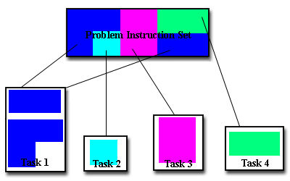
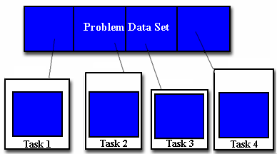
Domain Decomposition
Functional Decomposition
Functional decomposition lends itself well to problems that can be split into different tasks. For example
Ecosystem Modeling
Signal Processing
Climate Modeling
In this type of partitioning, the data associated with a problem is decomposed. Each parallel task then works on a portion of of the data.

Slide 32
Who Needs Communications?
The need for communications between tasks depends upon your problem
You DON'T need communications
Some types of problems can be decomposed and executed in parallel with virtually no need for tasks to share data. For example, imagine an image processing operation where every pixel in a black and white image needs to have its color reversed. The image data can easily be distributed to multiple tasks that then act independently of each other to do their portion of the work.
These types of problems are often called embarrassingly parallel because they are so straight-forward. Very little inter-task communication is required.
You DO need communications
Most parallel applications are not quite so simple, and do require tasks to share data with each other. For example, a 3-D heat diffusion problem requires a task to know the temperatures calculated by the tasks that have neighboring data. Changes to neighboring data has a direct effect on that task's data.

Slide 33
Factors to Consider (1)
There are a number of important factors to consider when designing your program's inter-task communications
Cost of communications
Inter-task communication virtually always implies overhead.
Machine cycles and resources that could be used for computation are instead used to package and transmit data.
Communications frequently require some type of synchronization between tasks, which can result in tasks spending time "waiting" instead of doing work.
Competing communication traffic can saturate the available network bandwidth, further aggravating performance problems.

Slide 34
Factors to Consider (2)
Latency vs. Bandwidth
latency is the time it takes to send a minimal (0 byte) message from point A to point B. Commonly expressed as microseconds.
bandwidth is the amount of data that can be communicated per unit of time. Commonly expressed as megabytes/sec.
Sending many small messages can cause latency to dominate communication overheads. Often it is more efficient to package small messages into a larger message, thus increasing the effective communications bandwidth.

Slide 35
Factors to Consider (3)
Visibility of communications
With the Message Passing Model, communications are explicit and generally quite visible and under the control of the programmer.
With the Data Parallel Model, communications often occur transparently to the programmer, particularly on distributed memory architectures. The programmer may not even be able to know exactly how inter-task communications are being accomplished.

Slide 36
Factors to Consider (4)
Synchronous vs. asynchronous communications
Synchronous communications require some type of "handshaking" between tasks that are sharing data. This can be explicitly structured in code by the programmer, or it may happen at a lower level unknown to the programmer.
Synchronous communications are often referred to as blocking communications since other work must wait until the communications have completed.
Asynchronous communications allow tasks to transfer data independently from one another. For example, task 1 can prepare and send a message to task 2, and then immediately begin doing other work. When task 2 actually receives the data doesn't matter.
Asynchronous communications are often referred to as non-blocking communications since other work can be done while the communications are taking place.
Interleaving computation with communication is the single greatest benefit for using asynchronous communications.

Slide 37
Factors to Consider (5)
Scope of communications
Knowing which tasks must communicate with each other is critical during the design stage of a parallel code. Both of the two scopings described below can be implemented synchronously or asynchronously.
Point-to-point - involves two tasks with one task acting as the sender/producer of data, and the other acting as the receiver/consumer.
Collective - involves data sharing between more than two tasks, which are often specified as being members in a common group, or collective.

Slide 38
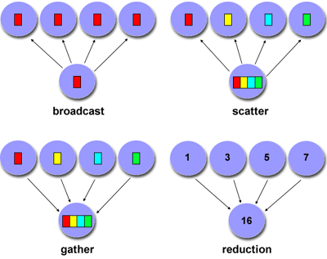
Collective Communications
Examples

Slide 39
Factors to Consider (6)
Efficiency of communications
Very often, the programmer will have a choice with regard to factors that can affect communications performance. Only a few are mentioned here.
Which implementation for a given model should be used? Using the Message Passing Model as an example, one MPI implementation may be faster on a given hardware platform than another.
What type of communication operations should be used? As mentioned previously, asynchronous communication operations can improve overall program performance.
Network media - some platforms may offer more than one network for communications. Which one is best?

Slide 40
Definitions
A dependence exists between program statements when the order of statement execution affects the results of the program.
A data dependence results from multiple use of the same location(s) in storage by different tasks.
Dependencies are important to parallel programming because they are one of the primary inhibitors to parallelism.

Slide 41
Examples (1): Loop carried data dependence
DO 500 J = MYSTART,MYEND
A(J) = A(J-1) * 2.0500
CONTINUE
The value of A(J-1) must be computed before the value of A(J), therefore A(J) exhibits a data dependency on A(J-1). Parallelism is inhibited.
If Task 2 has A(J) and task 1 has A(J-1), computing the correct value of A(J) necessitates:
Distributed memory architecture - task 2 must obtain the value of A(J-1) from task 1 after task 1 finishes its computation
Shared memory architecture - task 2 must read A(J-1) after task 1 updates it

Slide 42
Examples (2): Loop independent data dependence
task 1 task 2
------ ------
X = 2 X = 4
. .
. .
Y = X**2 Y = X**3
As with the previous example, parallelism is inhibited. The value of Y is dependent on:
Distributed memory architecture - if or when the value of X is communicated between the tasks.
Shared memory architecture - which task last stores the value of X.
Although all data dependencies are important to identify when designing parallel programs, loop carried dependencies are particularly important since loops are possibly the most common target of parallelization efforts.

Slide 43
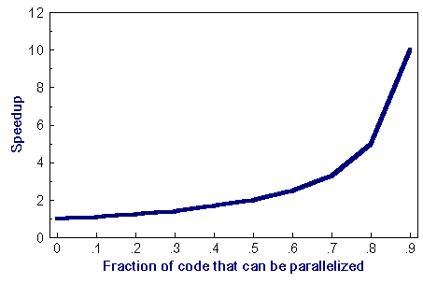
Amdahl's Law
Amdahl's Law states that potential program speedup is defined by the fraction of code (P) that can be parallelized:
1
speedup = --------
1 - P
If none of the code can be parallelized, P = 0 and the speedup = 1 (no speedup). If all of the code is parallelized, P = 1 and the speedup is infinite (in theory).
If 50% of the code can be parallelized, maximum speedup = 2, meaning the code will run twice as fast.

Slide 44
Amdahl's Law
Introducing the number of processors performing the parallel fraction of work, the relationship can be modeled by
where P = parallel fraction, N = number of processors and S = serial fraction
1
speedup = ------------
P + S
---
N

Slide 45
Amdahl's Law
It soon becomes obvious that there are limits to the scalability of parallelism. For example, at P = .50, .90 and .99 (50%, 90% and 99% of the code is parallelizable)
speedup
--------------------------------
N P = .50 P = .90 P = .99
----- ------- ------- -------
10 1.82 5.26 9.17
100 1.98 9.17 50.25
1000 1.99 9.91 90.99
10000 1.99 9.91 99.02

Slide 46
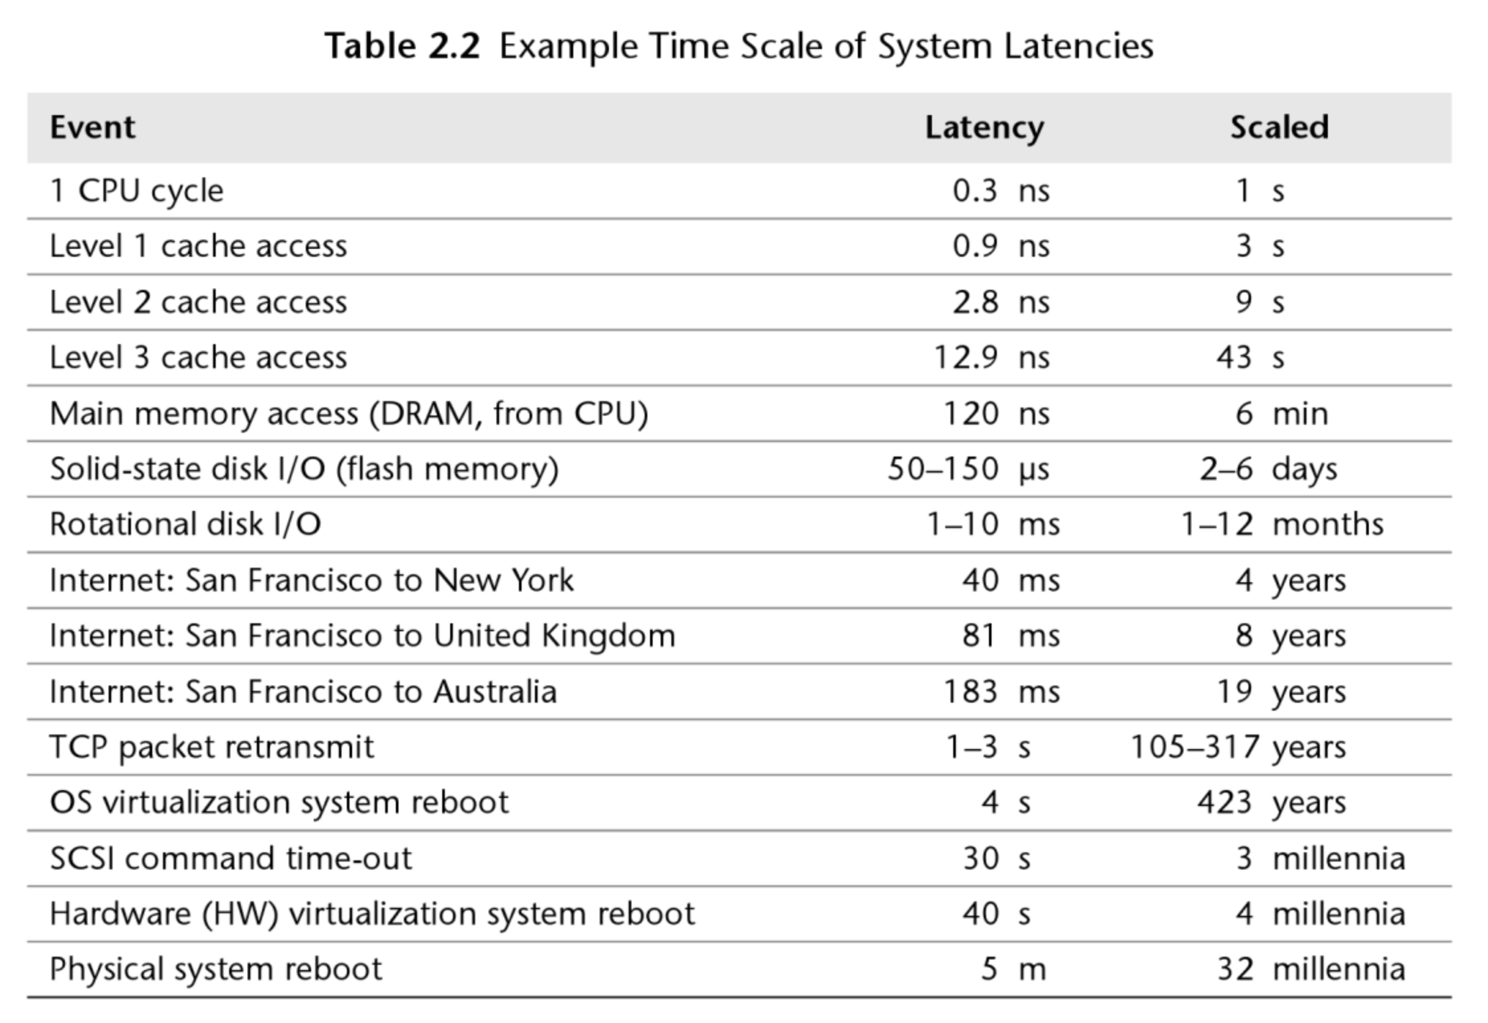


Slide 48
The Hadoop Eco-system
The base Apache Hadoop framework is composed of the following modules:
Hadoop Common – contains libraries and utilities needed by other Hadoop modules.
Hadoop Distributed File System (HDFS) – a distributed file-system that stores data on commodity machines, providing very high aggregate bandwidth across the cluster.
Hadoop YARN – a resource-management platform responsible for managing computing resources in clusters and using them for scheduling of users' applications.
Hadoop MapReduce – a programming model for large scale data processing.

Slide 49
Functionality
Data Management: YARN, HDFS
Data Access: Hive, Pig, MapReduce, Spark, Storm, HBase, Tez, Kafka, Hcatalog, Slider, Solar, Mahout, Accumulo
Data Governance and Integration: Falcon, Flume, Sqoop
Security: Knox, Ranger
Operations: Ambari, Oozie, Zookeeper
Description of these components

Slide 50
HDFS + MapReduce
map(key1,value) -> list<key2,value2>
reduce(key2, list<value2>) -> list<value3>

Slide 53
Usage: $HADOOP_PREFIX/bin/hadoop jar hadoop-streaming.jar [options]Options:
-input
<path> DFS input file(s) for the Map step.
-output
<path> DFS output directory for the Reduce step.
-mapper
<cmd|JavaClassName> Optional. Command to be run as mapper.
-combiner
<cmd|JavaClassName> Optional. Command to be run as combiner.
-reducer
<cmd|JavaClassName> Optional. Command to be run as reducer.

Slide 54
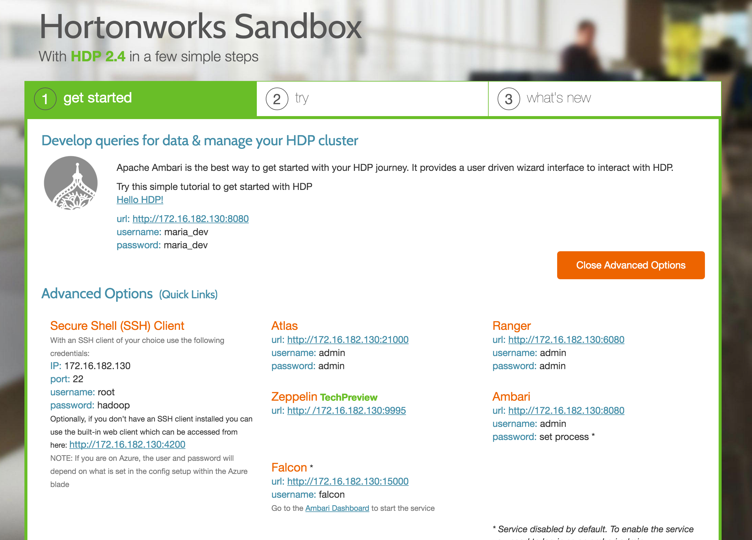

Slide 55
Sandbox Setup
Connecting
Create user account, make yourself sudoer
useradd -m -c "Max Headway" mheadway
passwd mheadway
vi /etc/group
SSH/SCP password-less access
Install additional packages on the sandbox
sudo yum install R

Slide 56
Cluster Login/Transfer Data
ssh/scp
Putty/WinSCP
FileZilla

Slide 57
Navigate HDFS
General Commands
hdfs dfs -usage
hdfs dfs -ls /
hdfs dfs –mkdir –p /home/mheadway
alias hls='hdfs dfs -ls $*'

Slide 58
Map-Reduce Streaming API
$ yarn jar /usr/hdp/current/hadoop-mapreduce-client/hadoop-streaming.jar \
-input /demo/data/Website/Website-Logs/* \
-output /home/pmolnar/streamout \
-mapper /bin/cat \
-reducer /bin/cat \
-numReduceTasks 2
$ yarn jar /usr/hdp/current/hadoop-mapreduce-client/hadoop-streaming.jar \
-info
$ export HSTREAMING="$HADOOP_PREFIX/bin/hadoop jar hadoop-streaming.jar"

